Slide 1
2
1
20
19
3
18
4
17
71.8 mm
(283 mil)
5
16
1.5 mm
6
15
7
14
8
13
9
10
11
12
25.4mm (100 mil)
Bonding Diagram for SOIC-20
Package is Kyocera PB-F86652C

Slide 2
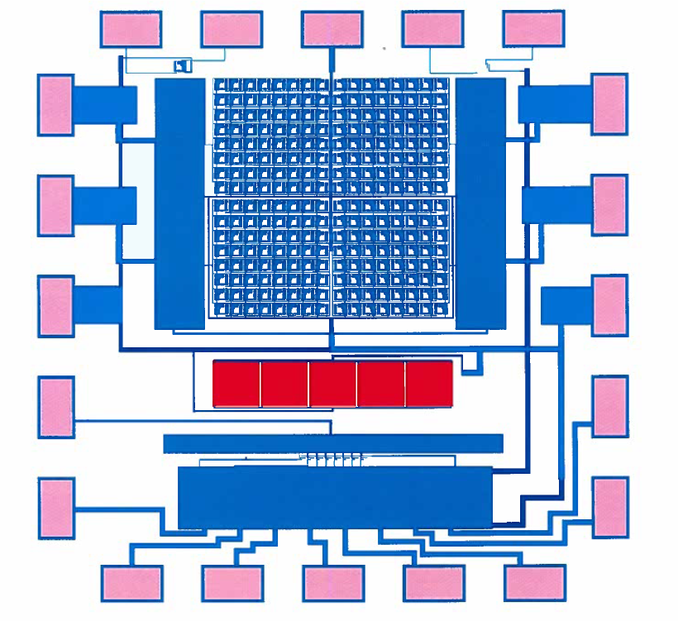
3
2
1
20
19
4
18
5
17
6
16
7
15
8
14
9
10
11
12
13

Slide 3
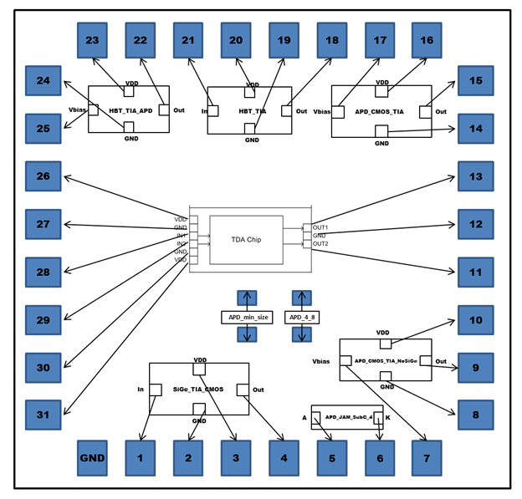

Slide 4
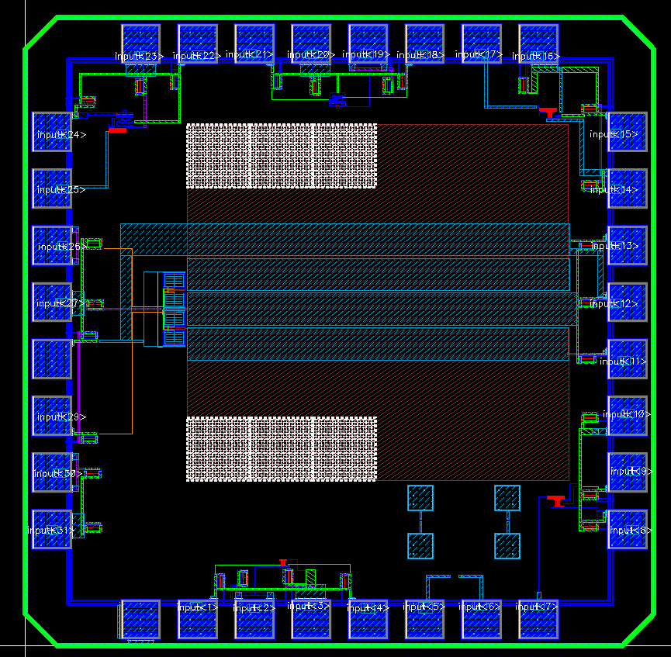

Slide 5
