Slide 1
EE 320L - Final Laboratory Project: Marshall MG-10 Guitar Amplifier
By: Octavio Gonzalez & Dane Gentry

Slide 2
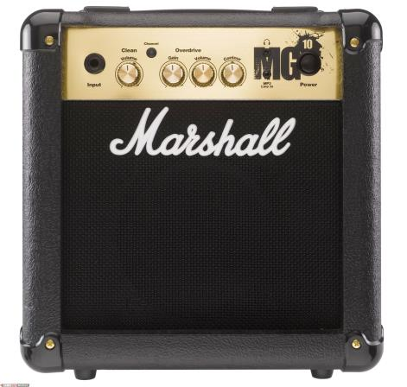
Description
Implementation of the Marshall MG10 Guitar Amplifier.

Slide 3



Engineering Roles
Dane Gentry:
  Conceptual
    Initial Project Scope
    Schematic Selection
  Procurement
    Cross-Reference/Parts List Generation
    Measurement/Tolerance Verification
    Component Mapping Sheet
    Parts Ordering
  Demonstration Materials
    Marshall Combo Cabinet Speakers
    Provided Guitar & Cables
  Implementation
    Integration Modifications (DPST)
    Soldering
  Demonstration/ Presentation
    Played Guitar for Amp Testing
    Organized Presentation Materials and PowerPoint
Octavio L. Gonzalez:
  Conceptual
    Purpose and Methods
    Relevancy and Guidance
  Integration/Design
    Specifications and Cross-Compatibility
    Modification Constraints
    Schematic Validation
    Layout and Sectionalizing
  Implementation
    Breadboard Implementation
    Integration/Revision Modifications
    Soldering, Fabrication, Construction
  Testing
    Primary Testing/Troubleshooting
    Circuit Verifications
  Demonstration/ Presentation
    Organized Presentation Materials and PowerPoint

Slide 4
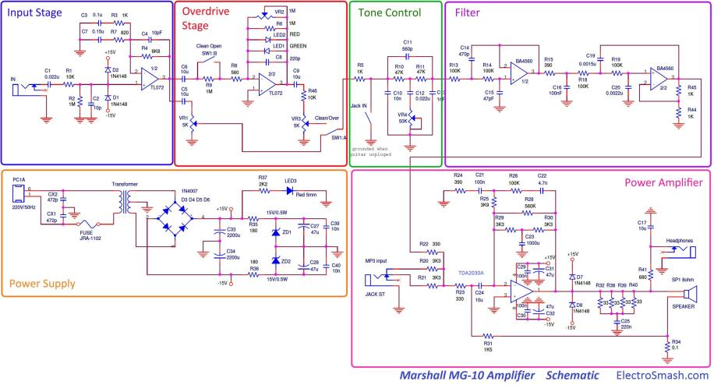
Marshall MG10 Guitar Amplifier Schematic

Slide 5
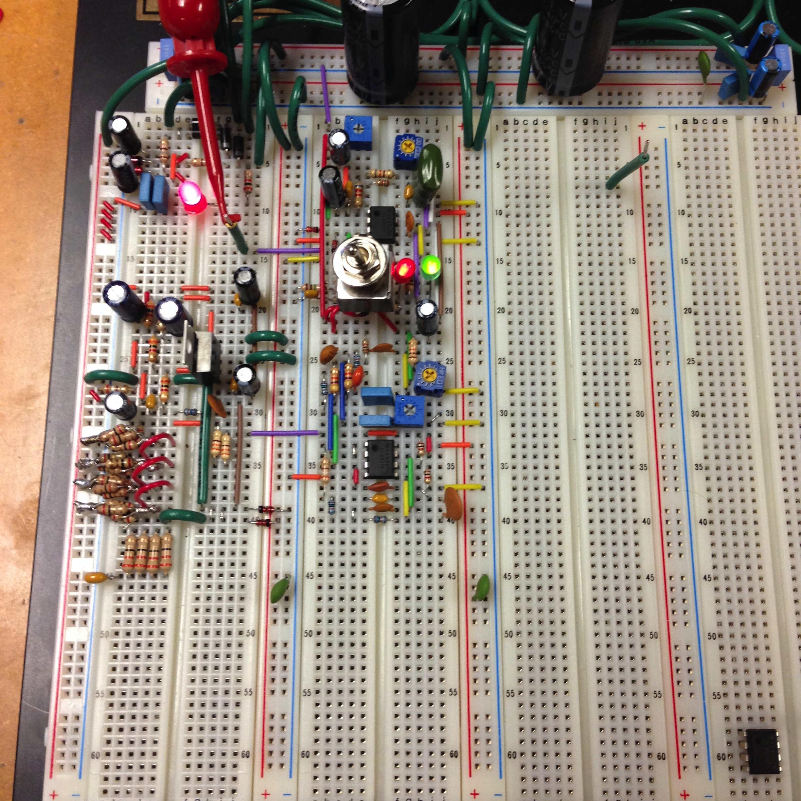
Power Supply Section
Implementation
Schematic

Slide 6
Input/Pre-Amp Section
Implementation
Schematic

Slide 7
Overdrive Section
Implementation
Schematic

Slide 8
Contour Section
Implementation
Schematic

Slide 9
Overdrive Section
Implementation
Schematic

Slide 10
Power Amp Section
Implementation
Schematic

Slide 11
Problems Encountered
Missing components.
  Used equivalent components as replacements & ordered components online
Missing 0.1 ohm (Ω) resistor
  Soldered four groups of five 2 ohm (Ω) resistors and placed in parallel to simulate 0.1 ohm (Ω) resistor (Twenty 2 ohm (Ω) resistors in parallel = 0.1 ohm (Ω))
Didn’t have a double-pole double-throw (DPST) switch
  Found DPDT switch but pins were larger than breadboard holes
  Soldered wires to pins of switch
Mistakenly connected AC to DC and destroyed the TDA2030 IC.
  Used back-up TDA IC
Broke pin off TDA2030 IC
  Soldered wire in place of broken pin

Slide 12
Conclusion
This Project provided insight to best circuit routing practices and noise mitigation.
It also improved soldering and fabrication skills.
The amp is loud and runs HOT!

Slide 13
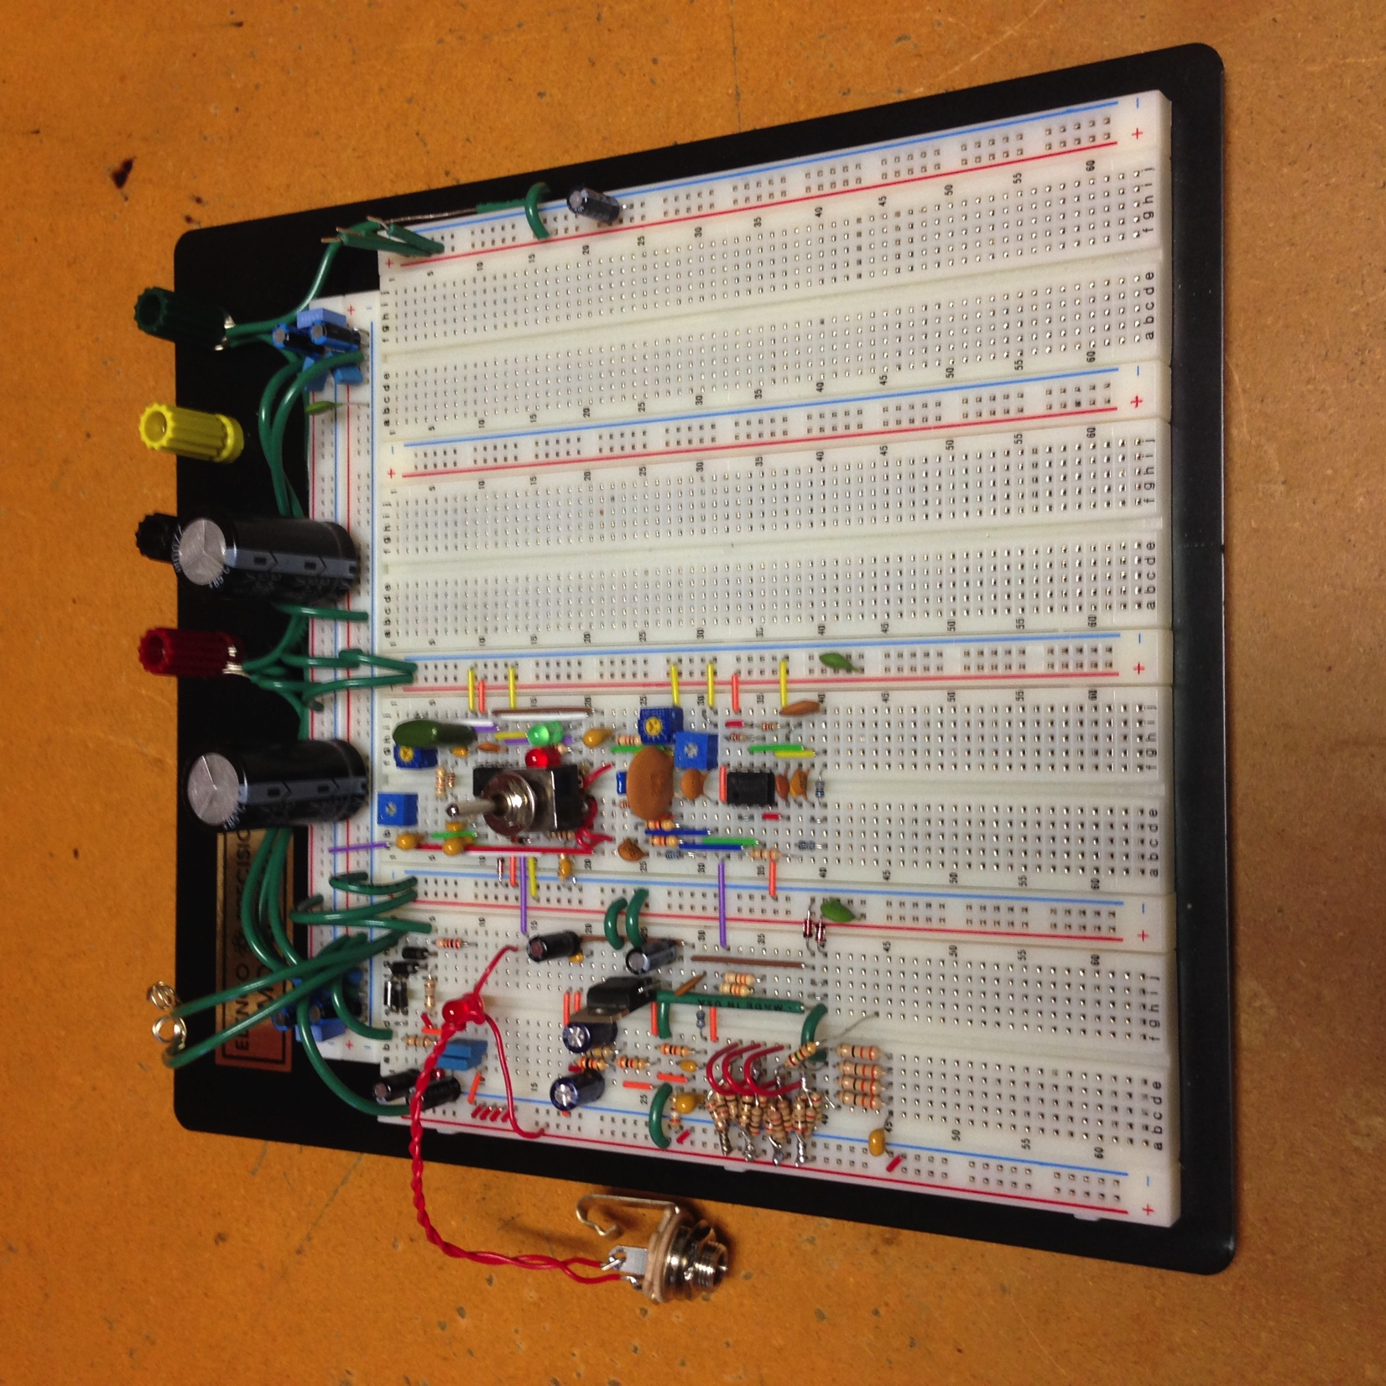
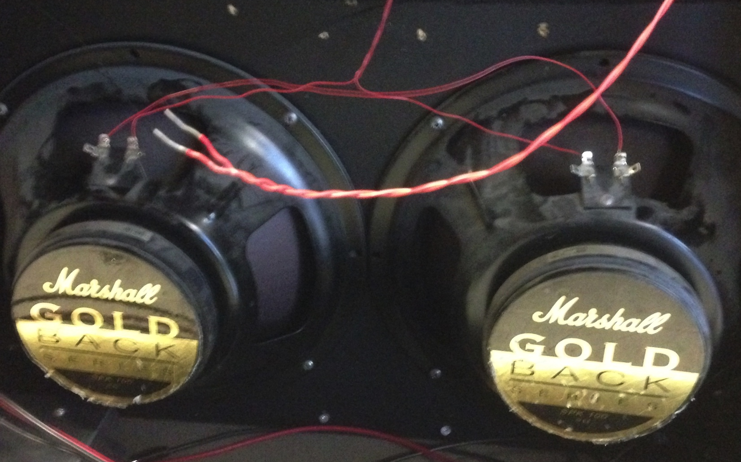
QA and Demo
16Ω Speaker Cabinet
Complete Implementation

