Slide 1
DE2 Board Slot Machine
By Byron Gorsuch & Dane Gentry

Slide 2
Project Description
Slot machine game implementation on DE2
Quartus circuit schematic
  3 random number generators each with a clock
    Counter Based Number Generator (CBNG)
  Comparator
    Win if all 3 random numbers generated are equivalent
      LED’s light up

Slide 3
Roles of Group Members
Byron Gorsuch:
  Brainstorm of potential projects
  Quartus circuit schematic design
  Generation of simulation waveform
  Obtained DE2 board for implementation
  Final project report
  Final PowerPoint presentation

Slide 4
Roles of Group Members
Dane Gentry:
  Brainstorm of potential projects
  Obtained DE2 board for implementation
  Pin assignments
  Implementation of Quartus circuit schematic onto DE2 board
  Final project report
  Final PowerPoint presentation

Slide 5
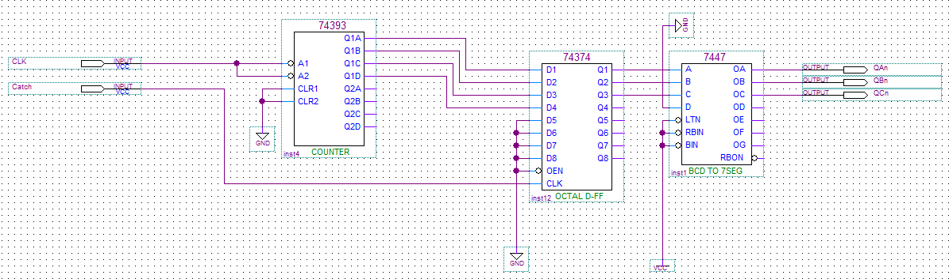
Quartus Circuit Schematics
Original CBNG Schematic

Slide 6
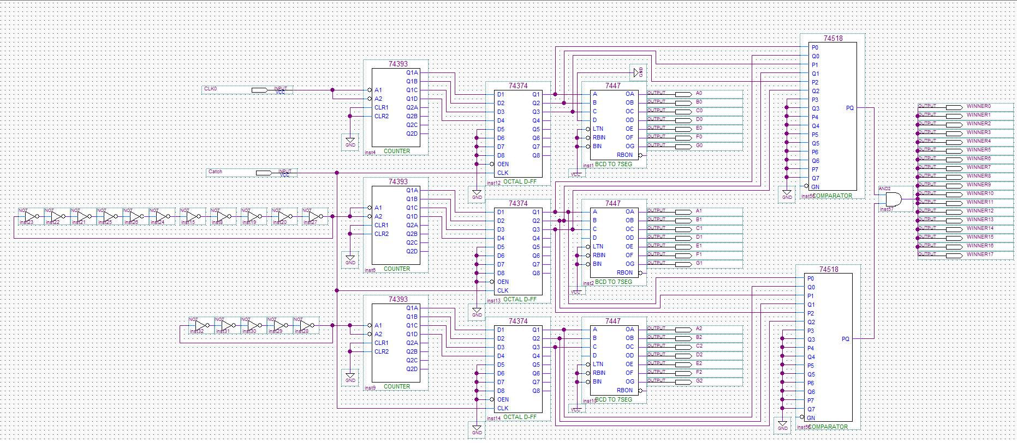
Quartus Circuit Schematics
Final Slot Machine Schematic

Slide 7
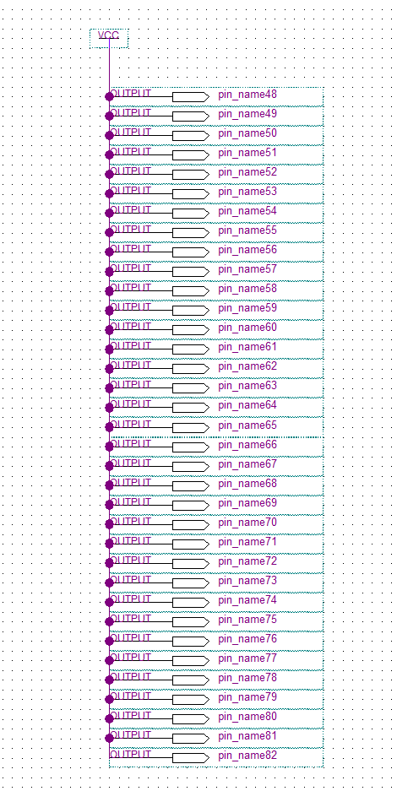
To black out unused 7-segs

Slide 8
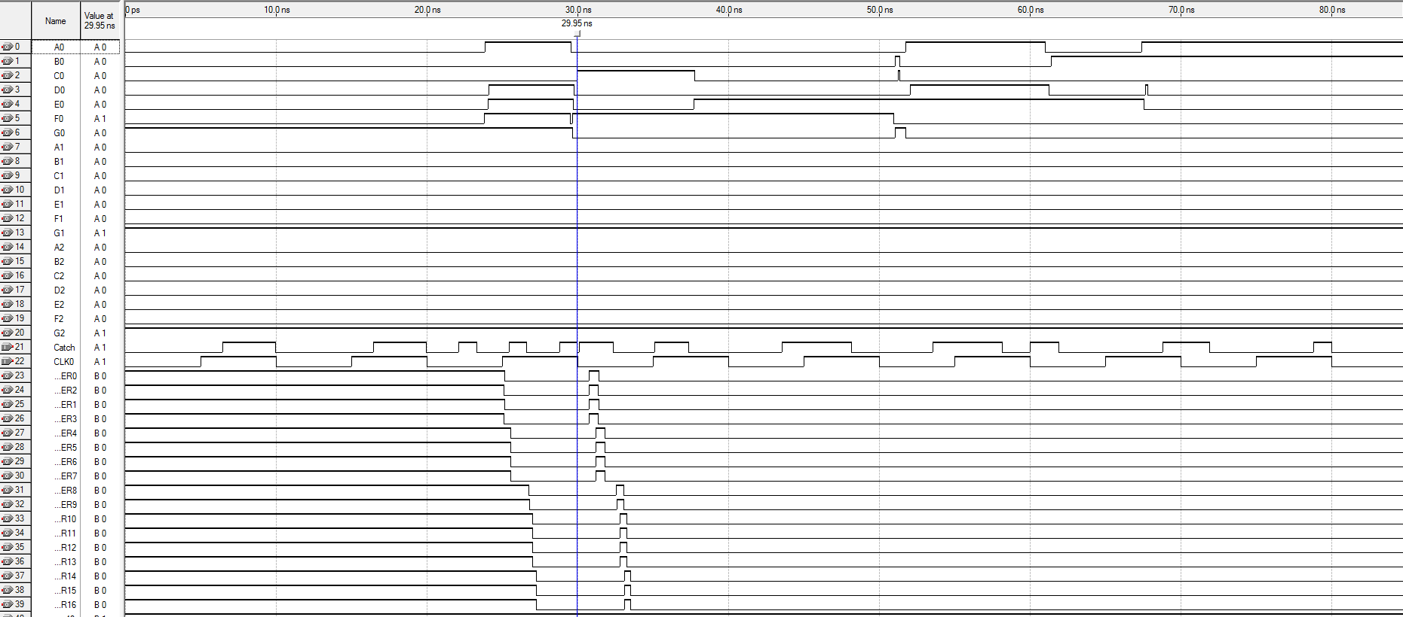
Simulation Waveforms Generated in Quartus

Slide 9
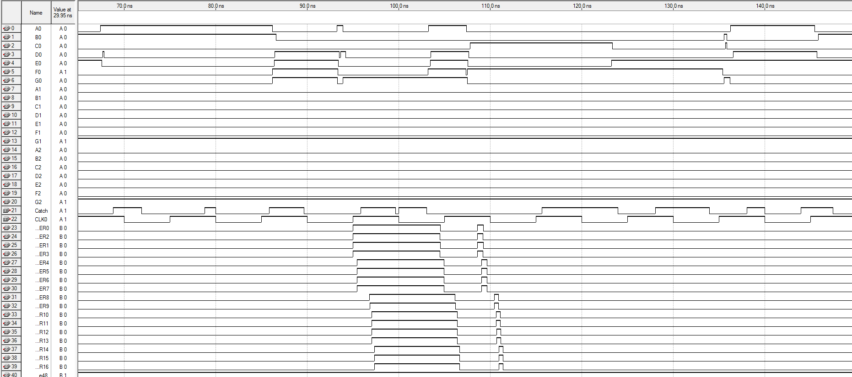
Simulation Waveforms Generated in Quartus

Slide 10
Issues & Solutions
27 MHz clock didn’t work
Assigning pin_D13 (pin for 27 MHz clock according to pin table) to input of 1 of CBNGs ➔ Output remained at 0
Tested design on multiple DE2 boards ➔ Not hardware error
Function generator as DE2 external clock ➔ Clock wouldn’t cycle on its own ➔ Had to manually attach and detach probe from function generator to DE2 board
Solved by using cascade of inverters to form ring oscillators as clock (from Lab 3)

Slide 11
Interesting Information
Slot machines in casinos work just like ours. Moment the button on machine is pressed, game will choose 1 random # for each reel and stop reel at that appointed position. Spinning reels and lights in casinos are just for show

Slide 12
Interesting Information
In theory, one could win at our slot machine every time. Since we used counter based random number generators (CBNG’s) which are not true random number generators, each reel in slot machine changes at constant rate. Possible to measure speed at which each reel changes and press button exactly when winning value is expected to appear. #’s shift so fast, however, that this is beyond human reflexes

Slide 13
Conclusions
Each “reel” has 8 possible values. Any set of 3 matching #’s is a winner. Probability of winning our slot machine is 1/64 (assuming true randomness) ➔ 1.56% chance to win
For a slot machine, it is ideal for the RNG to be unpredictable which is why CBNG is favorable to a linear feedback shift register (LFSR) which has a cyclic process and once figured out can be beat every time.
If a specific clock speed is not required, a ring oscillator is a simple way to create a clock and can be done with a single IC.

