Slide 1
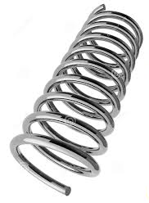
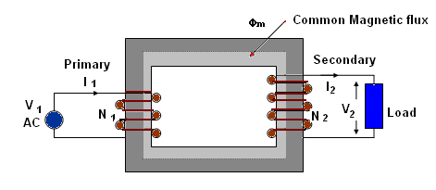

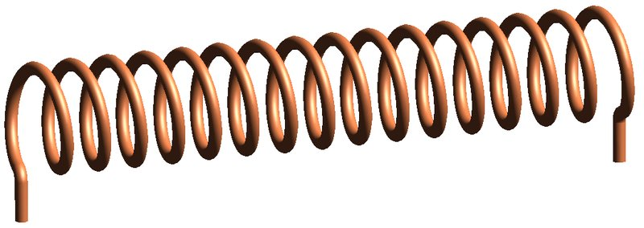


Inductors and Transformers:
The magic behind a coil of wire
David Santiago EE221L

Slide 2
Inductors and Transformers: Prologe
1. I questioned how the pre-made inductors worked:
  I tried to recreate the transformer lab with the premade inductors but the inductors are made with a special coating to prevent magnetic leakage.
2. I didn’t really understand the dot convention system on a physical inductor.
  How do you coil the wire?
3. I thought this project would be an easy A
  I was wrong at the end, this project was hard (but I learned a lot).

Slide 3
Roles:
Making the inductors: David S.
LTSpice simulations: Also Me
Breadboard Circuits: Me
Powerpoint: He’s right in front of you ☺

Slide 4
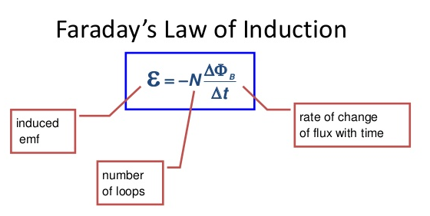
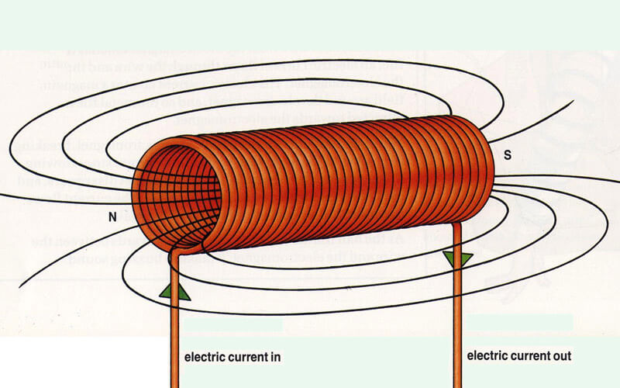
Back to Basics – Physics of the Inductor
Inductors are coils of wire that create a magnetic field when current runs through it.
Faraday’s law relates the rate of change in the magnetic flux through a loop to the magnitude of the Voltage.

Slide 5
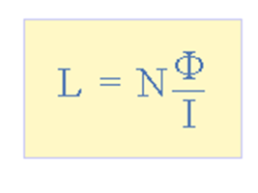
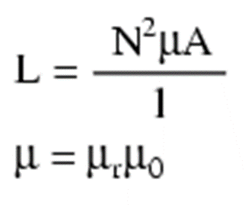
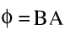
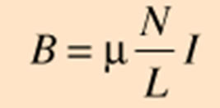
Back to Basics – Physics of the Inductor
The equation to calculate the inductance is:
The magnetic flux is:
The equation of a solenoid is:
Combining all 3 equations gets you:
L in Henrys (H)
N – Turns
A – Area (m)
l – length of coil (m)
u – Relative permeability (1) times the permeability of free space (4π x 10˄-7)

Slide 6
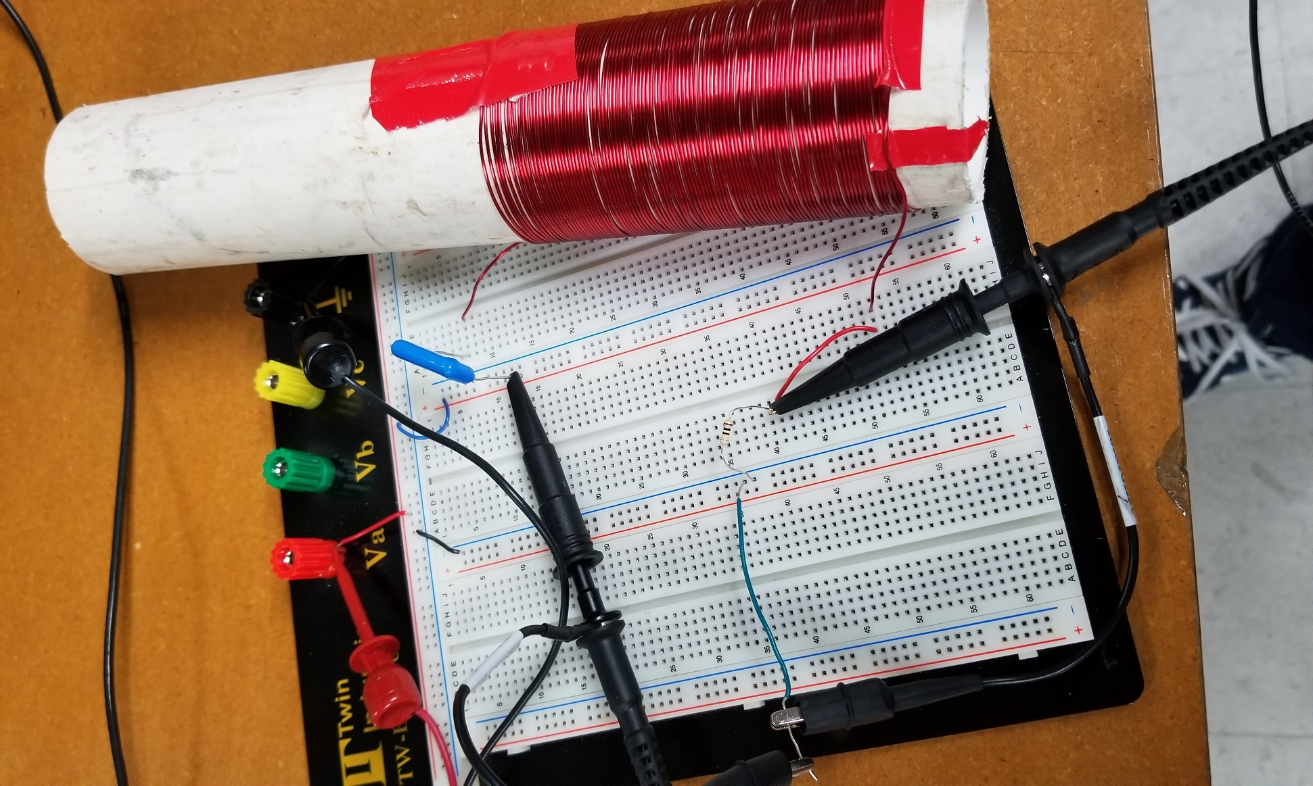
Calculating the inductance of a big coil:
N = 100 Turns
Radius = 2.5cm
Length = 9.5
Inductance = 259 microHenries

Slide 7
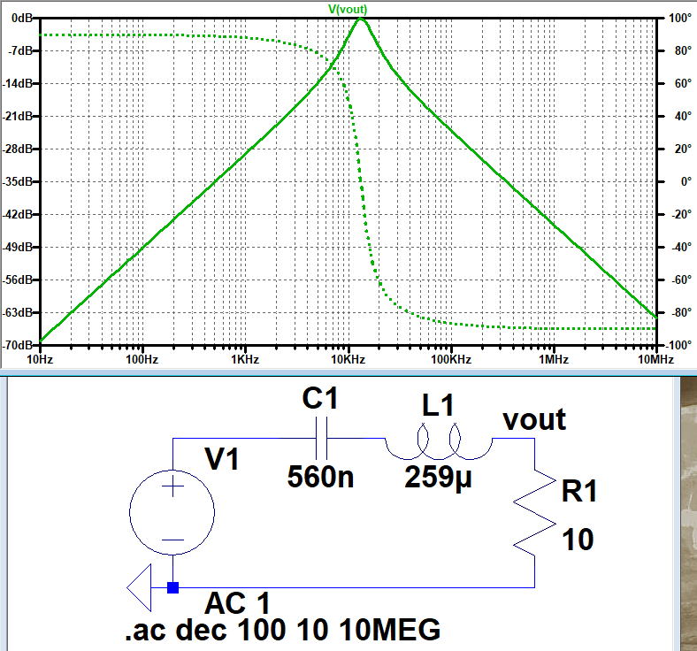
Calculating the inductance of a big coil: Experiment
To experimentally calculate the inductance of the coil, we use an LC oscillating circuit:

Slide 8

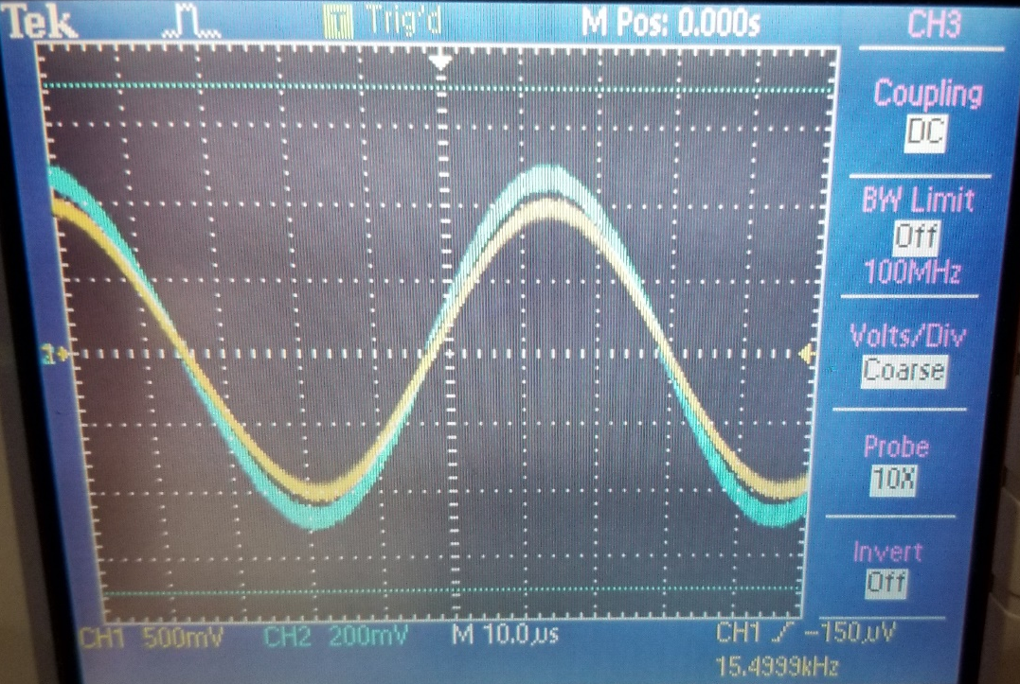
Calculating the inductance of a big coil: Experiment
Using 2πf = 1/sqrt(L x C), we can calculate the inductance on a breadboard by “sweeping through the frequencies using the function generator.
F = 15.5kHz
C=560nF
Inductance = 193uH

Slide 9
Calculating the inductance in a big coil: Results
Theoretical = 259uH
Experimental = 193uH
Percent error: (Theo – Ex)/Theo = 25% Error
For the theoretical inductance, it assumes perfect winding of the coils.
My windings were good, but had some gaps in between the coils.

Slide 10
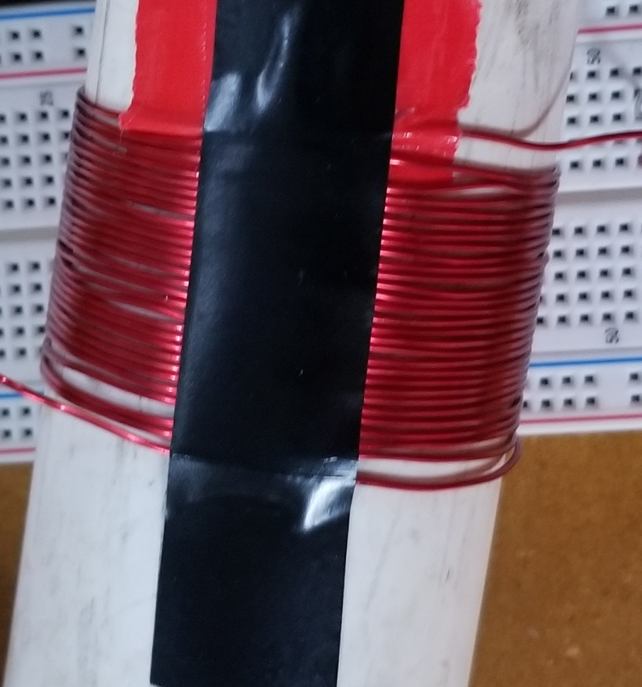
Calculating the inductance of a small coil:
N = 25
Radius = 2.5cm
Length = 3.5cm
Inductance = 44 microhenries

Slide 11
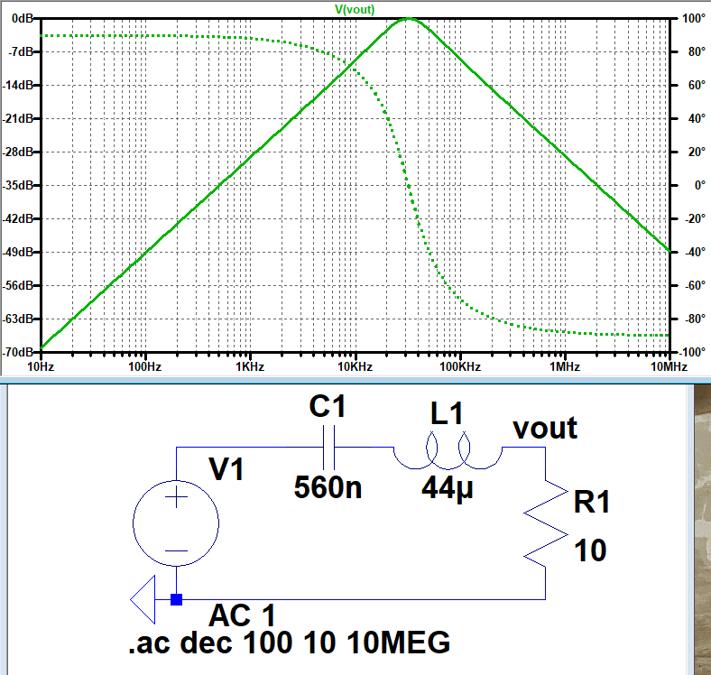
Calculating the inductance of a small coil: Experiment

Slide 12
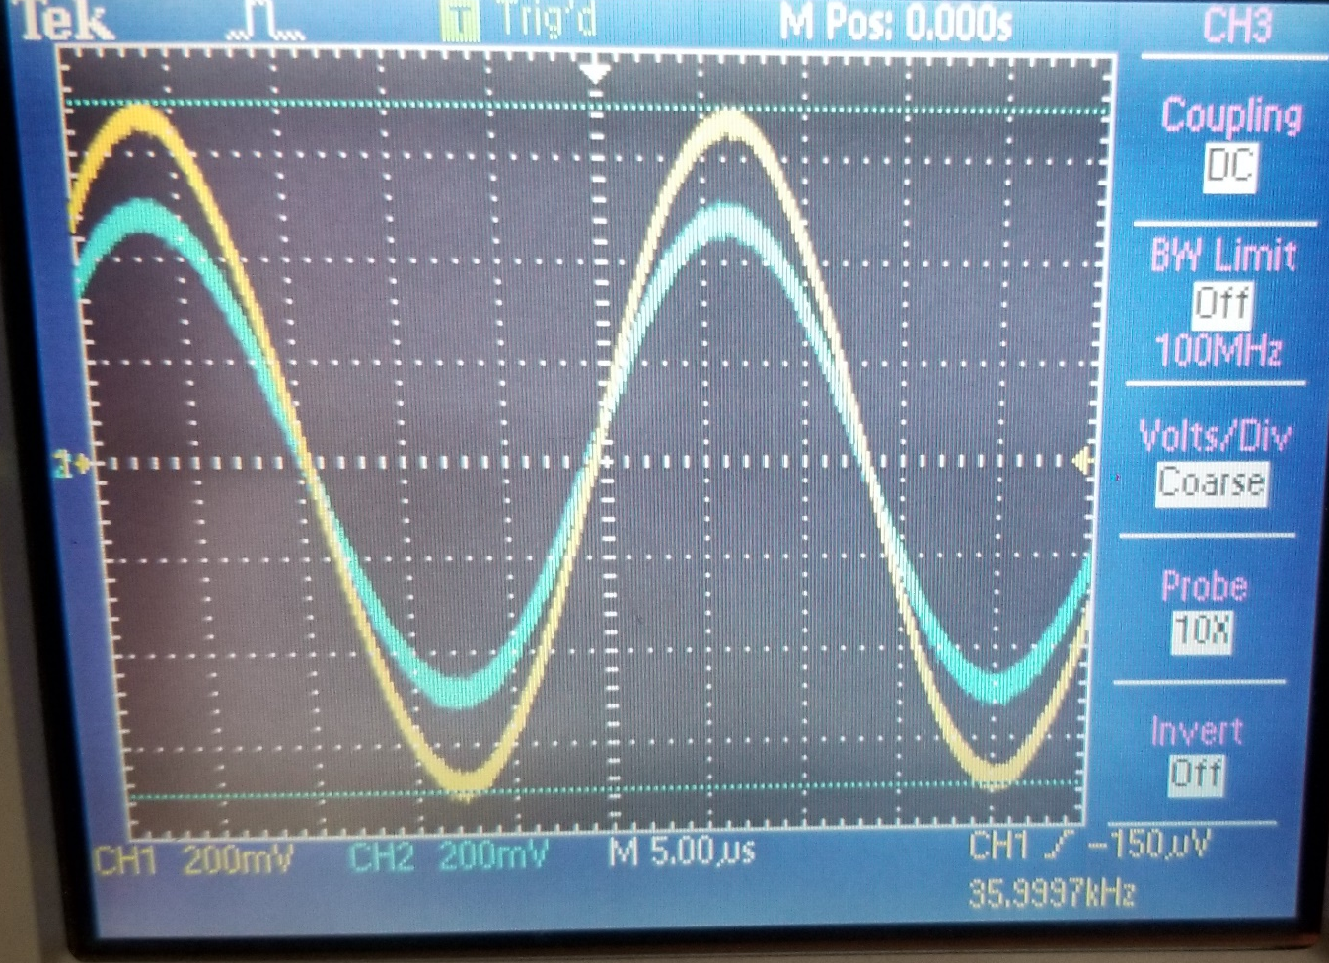

Calculating the inductance of a small coil: Experiment
F = 36kHz
C = 560nF
Inductance = 36uH

Slide 13
Calculating the inductance of a small coil: Results
Theoretical = 44uH
Experimental = 36uH
Percent error = 18%
Same with the big coil, the theoretical assumes tightly coiled wires, the error could of come from the very small insulation of the wire i used.

Slide 14
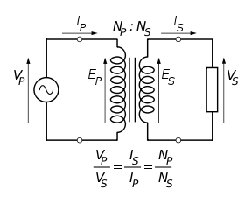
Making a 100:25 Turn Transformer
The formula for an ideal Transformer is:
Vprimary/Vsecondary = Np/Ns
Using the results from the big and small coils, we should theoretically get Vsecondary to be 1/4th of Vprimary.

Slide 15
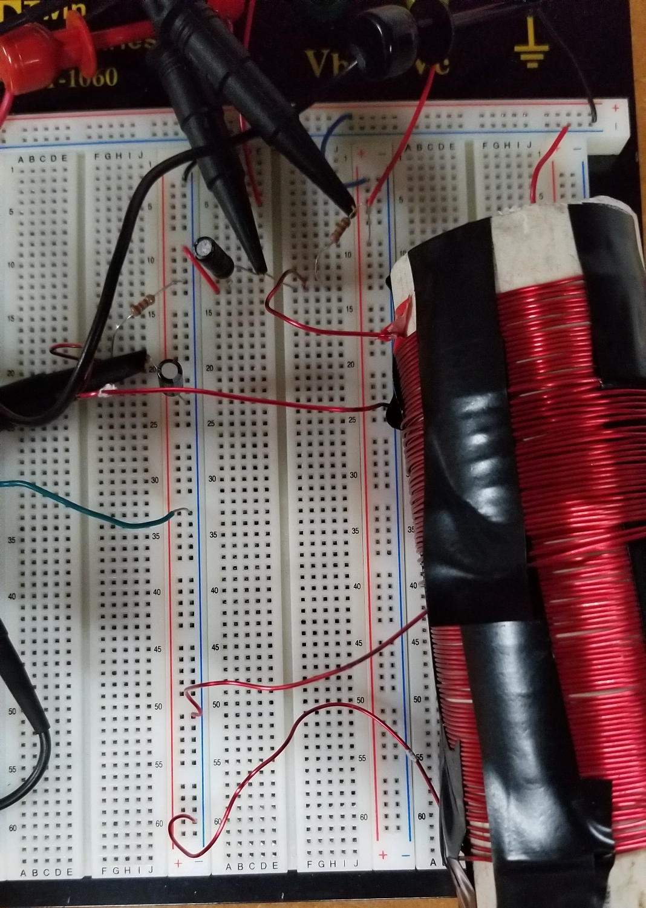
The Transformer:
For the transformer, I placed the small coil on top of the big coil and also had both of the inductors coiled in the same direction (so that both have the same dot convention direction)
The capacitors are there for reasons that will be explained later.

Slide 16
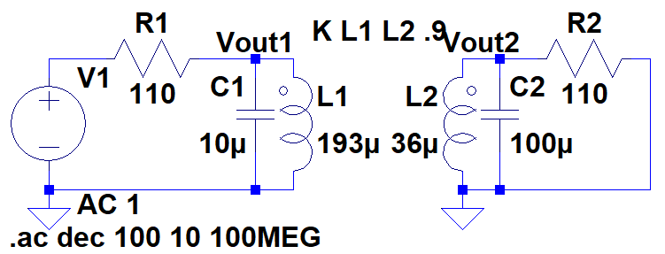
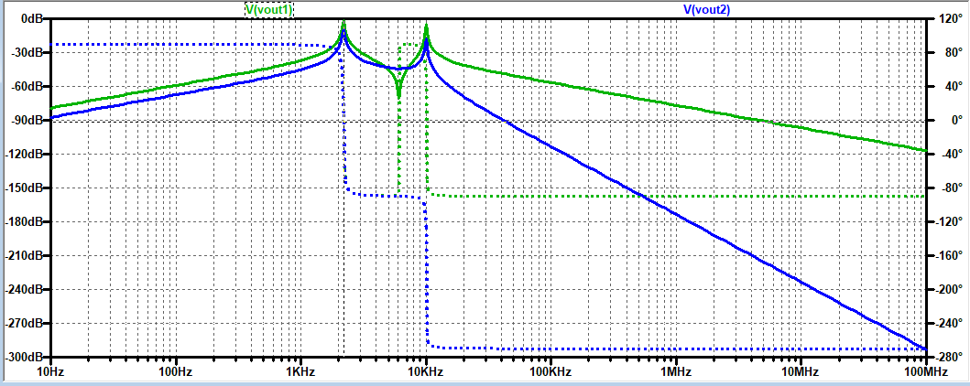
The Transformer: LTSpice

Slide 17
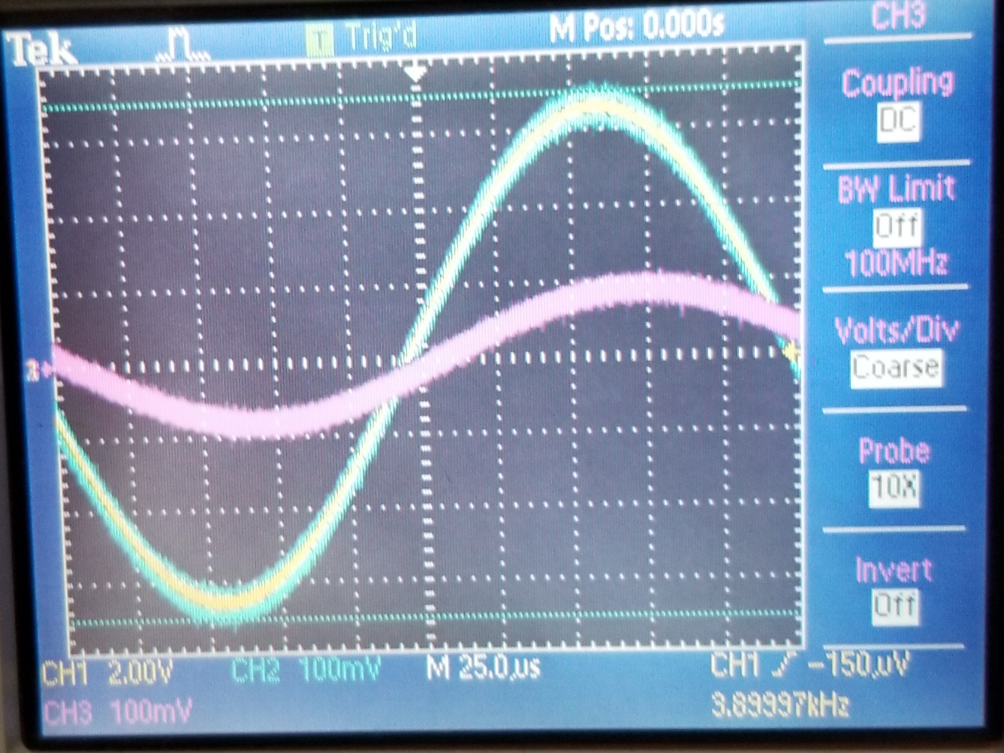
The Transformer: Results
Peak Voltage frequency: 3.9kHz
Vprimary = .71V
Vsecondary = .2V
Vp/Vs experimental = 3.55
Vp/Vs Theoretical = 4
Percent error = 11.3%

Slide 18
Problems:
The first problem: Nothing in the world is perfect (or ideal).
  The inductors I made actually had a small parasitic capacitance between the windings (so that means the capacitance was in parallel with it).
Because of the capacitance, it affected how the inductor behaves at very high frequencies (20MHz).
I solved this problem by killing the small capacitance with a huge capacitance in parallel (10uF and 100uF capacitors).

Slide 19
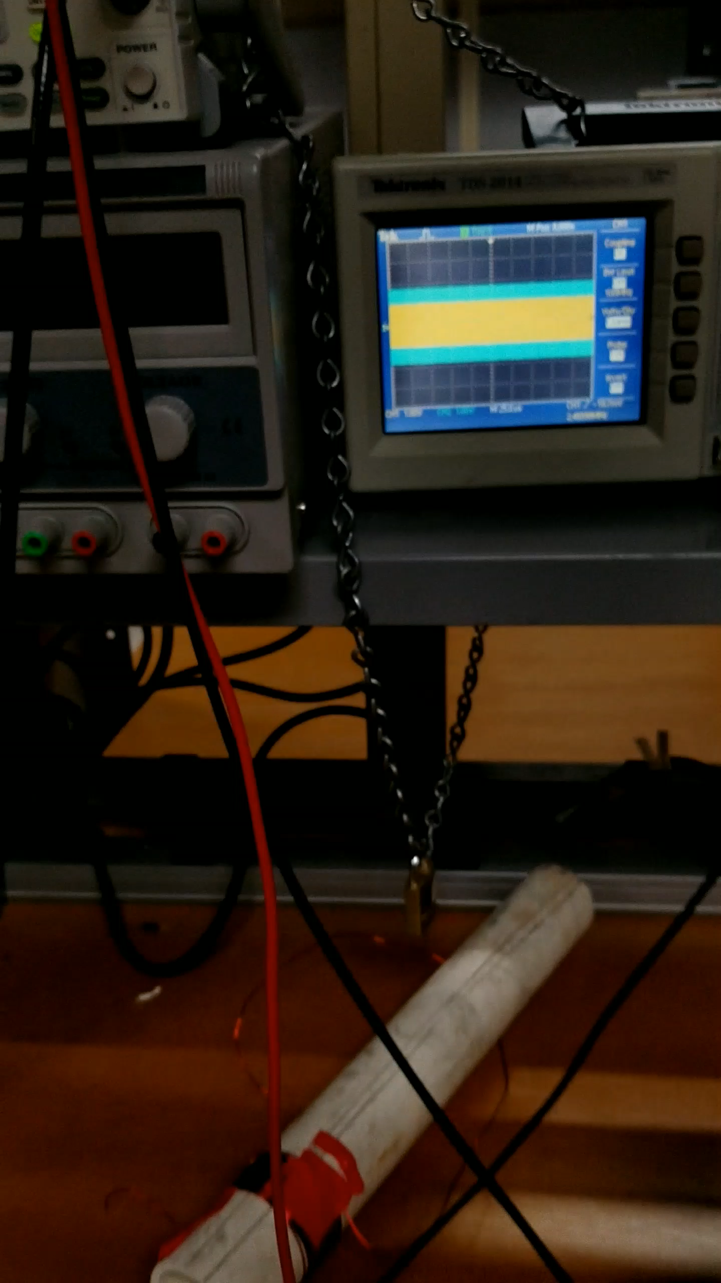
Problems: I AM a capacitor
Apparently, at around 2MHz, the parasitic capacitance shows.
Only being a few centimeters from the inductor at this frequency makes the capacitor increase.
Parasitic capacitance can be solved knowing the inductance = 193uH.
Parasitic capacitance = 33pF

Slide 20
Conclusion:
This project was mostly a physics research-based project.
All coils of wire can have an inductance
Coils of wire aren’t perfect and have a parallel capacitance that can be changed with more capacitors.
Transformers are also not perfect, but real transformers have high inductance and also metal-core centers to perfectly couple inductors.
This project wasn’t an easy A (it was more of a harder A project to achieve)

Slide 21
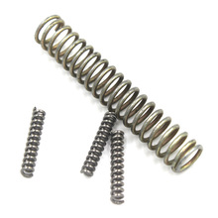
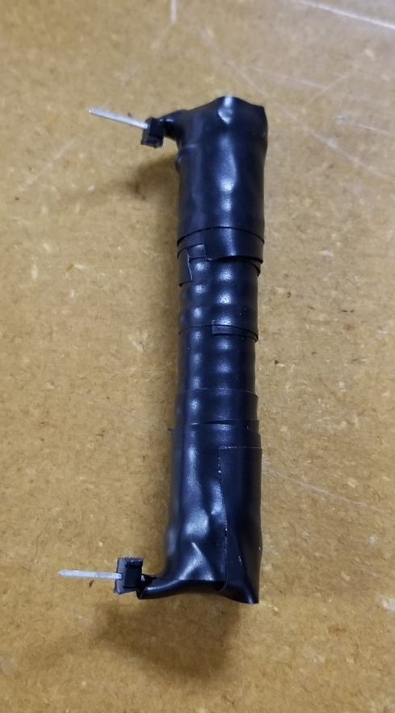
Bonus!
I found a coil of wire (a very strong spring) while walking down the street and said, “Hey, that’s my project!”
Knowing that coils of wire are inductors, I wanted to solve for this inductance to see if it had inductance.

Slide 22
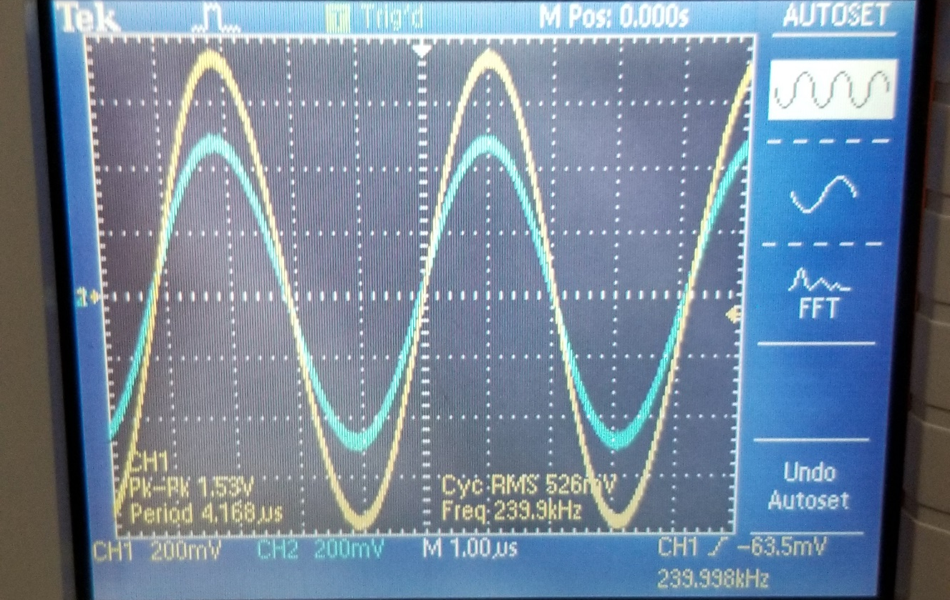
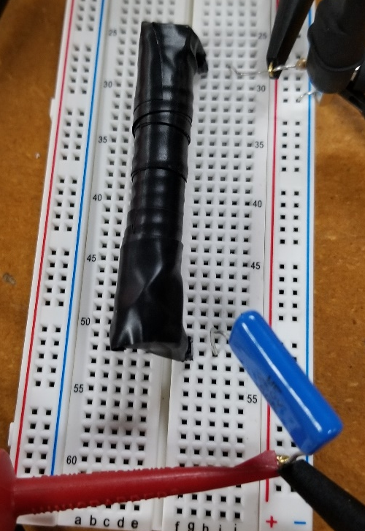
Bonus!
And yes, this little spring did have an inductance!
F = 240kHz
C = 560nF
Inductance = .79uH

Slide 23
Thank You!

