Slide 1
AVNRT
Atrioventricular Nodal Reentry Tachycardia

Slide 2
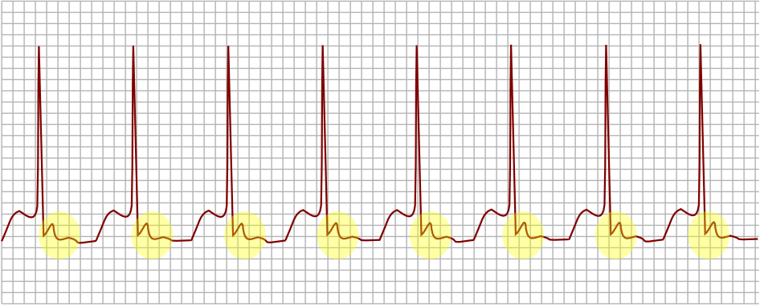
PATIENT IN AVNRT: EKG
Micro reentry circuit
Paroxysmal
Must have a slow and a fast pathway
EKG - P Wave closely coupled after QRS (or inside QRS) because the circuit is going down the slow pathway and up the fast pathway

Slide 3
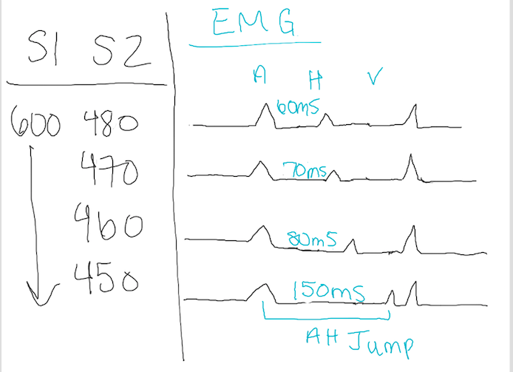
AH JUMP
Decremental conduction
Indication of slow pathway
50+ ms prolongation in AH with 10 ms shortening of S2

Slide 4
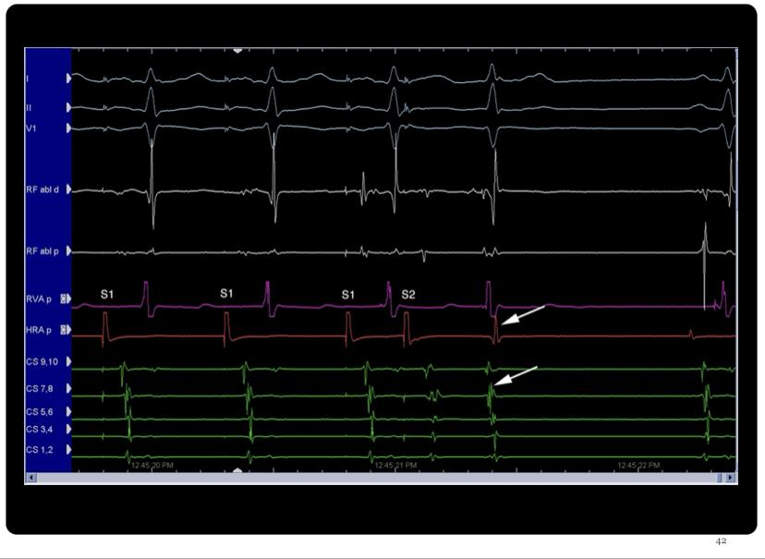
ECHO BEATS
AV Nodal Echo – one journey of re-entrance
Pulsing the HRA (Programmed Stimulation)
AVNRT is usually characterized by several of these beats

Slide 5
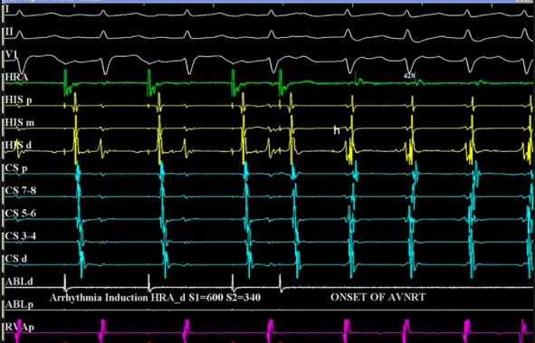
PATIENT IN AVNRT: EMG
Characterized by several echo beats
This patient will be diagnosed with AVNRT.

Slide 6
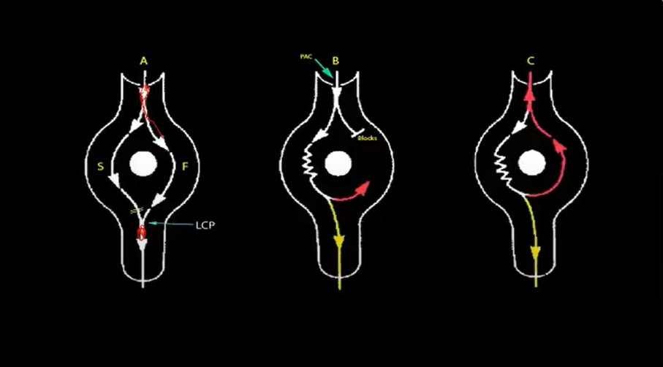
AVNRT CONDUTION
Down the slow pathway, up the fast pathway
Slow pathway - fast refractory
Fast pathway - slow refractory

Slide 7
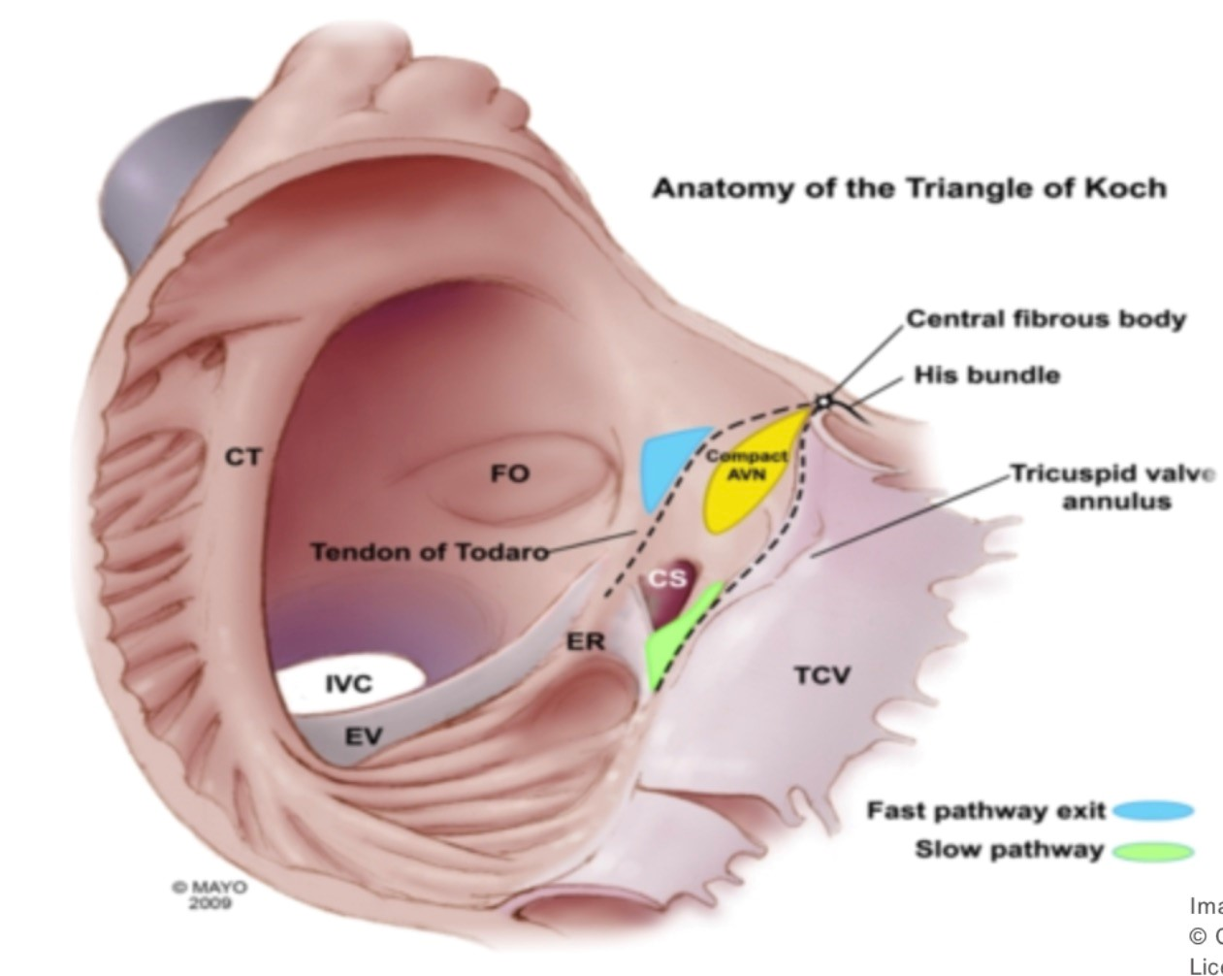
ABLATION
Target: slow pathway
Small and sensitive area
Burning inferior and posterior to the AV node; very close to the His
Stop ablation if an A signal is seen without a V – sign of heart block
Successful when there is no tachycardia induction
No echo beats, no AH jump
Wenckebach cycle length longer

Slide 8
Thank you!

