Slide 1
Atrial Flutter
Jazmine Boloor

Slide 2

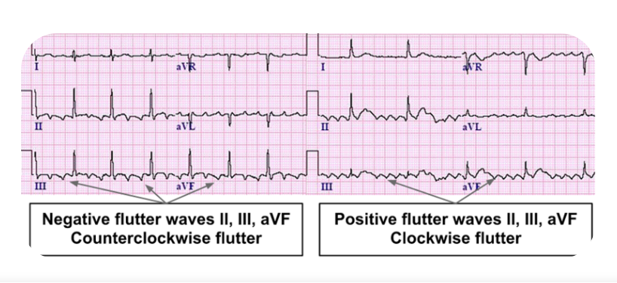
FLUTTER: EKG
Paroxysmal, macro reentry circuit
Presence of abnormal conduction within atria, as well as AV node conduction block
Sawtooth P waves
  Typical CCW (90%): Lead II, Lead II, and aVF show negative sawtooth P waves
  Atypical Flutter: any other flutter (can be positive sawtooth)

Slide 3
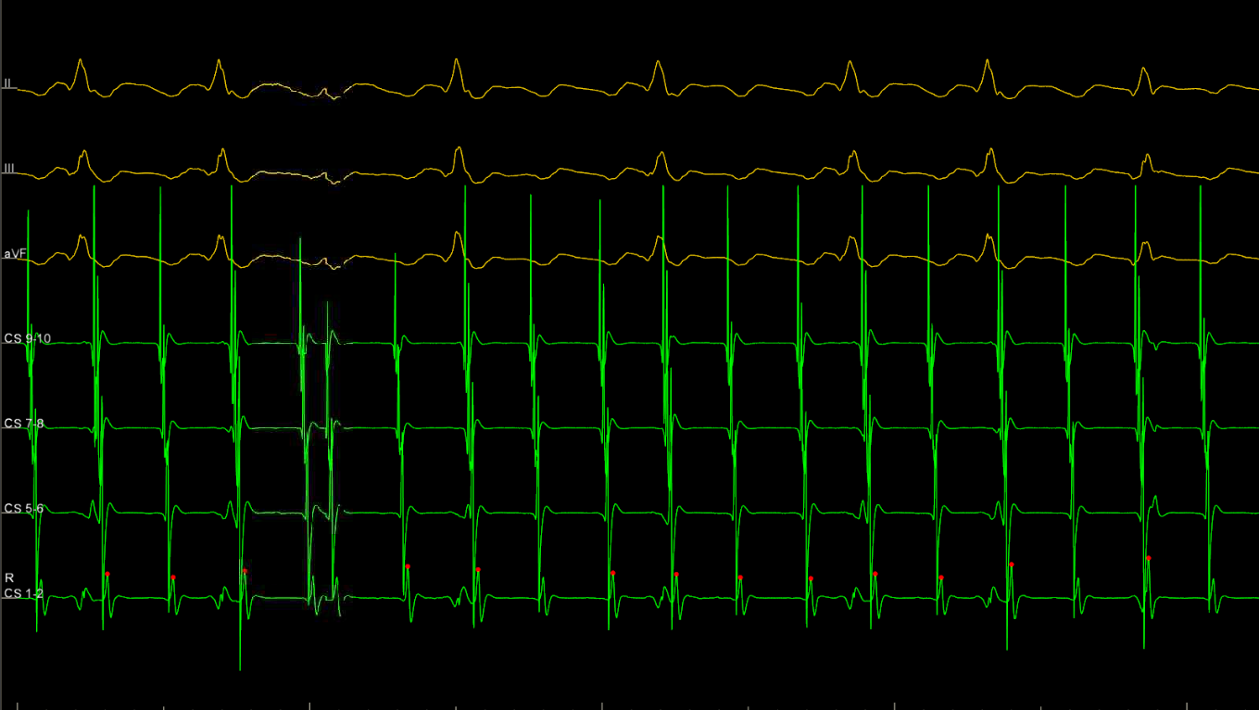
TYPICAL FLUTTER: EMG
Several negative sawtooth P waves associated with each QRS wave
Concentric activation from CS 10 to 1

Slide 4
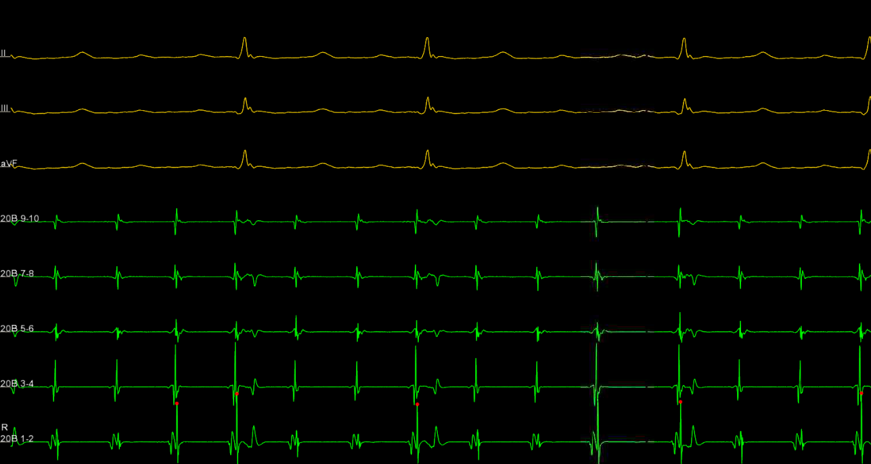
ATYPICAL FLUTTER: EMG
Several positive sawtooth P waves associated with each QRS wave
CS is showing stacked signals– not concentric
Left atrial flutter around mitral valve

Slide 5
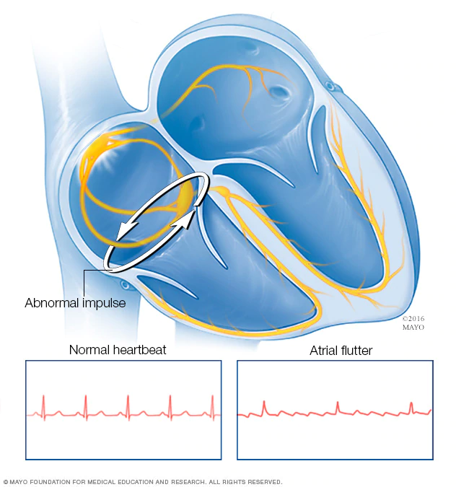
DIAGNOSIS
If a patient is in normal sinus rhythm, burst pace to induce tachycardia
  Extra stims may be used
This patient is diagnosed with typical flutter.
  Reentry circuit within the right atrium
  Showing negative sawtooth waves

Slide 6
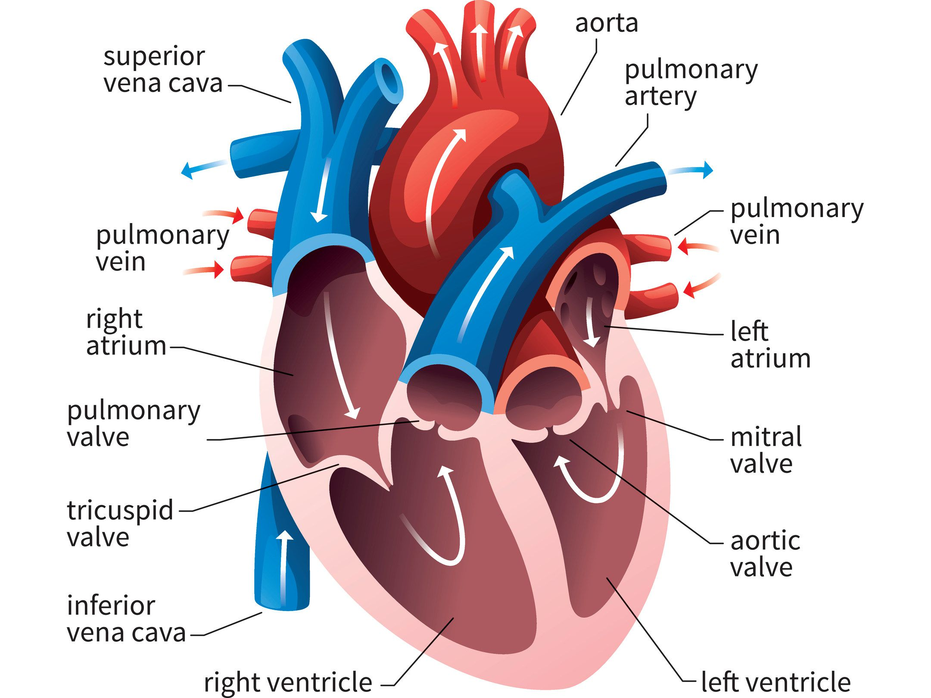
ABLATION
Target: burn a line of block from the IVC to the tricuspid valve.
Alternatively, for atypical flutter, the patient would have to be put into arrythmia (burst pacing) and mapped to find where flutter is coming from. Then, a line of block can be burned.
  Two nonconducting structures
Successful ablation will result in normal sinus rhythm that does not induce tachycardia

Slide 7
Thank you!

