Slide 1
Electrical and Comp. Engineering University of Nevada, Las Vegas IEEE 58th International MWSCAS 2015, Fort Collins Colorado, USA Title: Buffer Sizing of Concentrated Photovoltaic Batteries: An Economic Analysis
Presented by
Yacouba Moumouni, Ph.D. Candidate
Co-author :
R. Jacob Baker, Ph.D

Slide 2
Contents
1. Abstract
2. Introduction
3. Battery basic principles
4. battery parameters calculation
5. charging and discharging analysis
6. Economic analysis
7. Conclusion
8. References
Questions and Answers

Slide 3
1. Abstract
Energy storage systems (ESS) is vital for grid-tied PV
Widespread ESSs are “Used electric vehicles’ battery”
Second-life batteries are less expensive
Investigates the economic performance of grid-tied CPV and buffers.
Results showed the unit was capable of a constant 20 kW and was able to shift the less valuable off-peak power to on-peak, where the cost of electricity was higher.
Paper addresses 1) techniques behind battery-sizing scenarios, 2) battery-parameter calculations involved in CPV output smoothing and/or electrical load shifting, and 3) Used Electric Vehicle battery cost estimation
Estimates of the cost effectiveness could be positive if the ESS prices drop to $375/kWh or lower.

Slide 4
2. Introduction
Population on Earth has increased ever than before
Fossil fuels (Oil, NG, and Coal) are depleting
Renewable resources are solutions
RE affects grid stability without proper buffer
Used EV batteries were proposed for economic and environmental reasons
EV batteries with 80% or less capacity, were good candidates for RE storage applications for a few more years

Slide 5
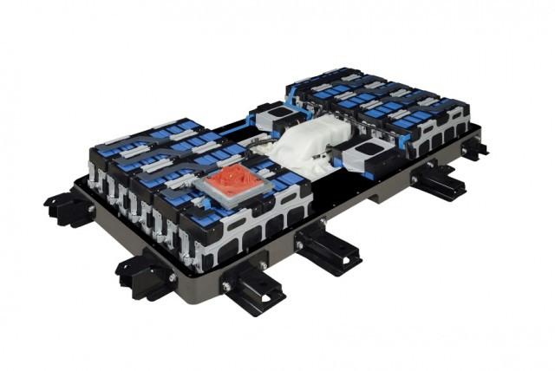
3. Battery basic principles
Batteries –chemical or mechanical devices
Stores Energy in different from
Losses in round trip
Non-rechargeable (primary cell), and
Rechargeable (secondary cell)
Trips at a DOD of 20%.

Slide 6
4. battery parameters calculation
Amount of exchangeable power is limited by 1) power rating and 2) battery capacity
Battery sizing is a delicate (Transients and Shifting)
Crucial Factors, such as the anticipated daily kWh of load and the number of hours or days of autonomy
Larger battery ⇒ offer more effective net positive aspects ⇒ more expensive
Growth in EV industry ⇒ high initial cost can be minimized ⇒ proposed Used EV batteries as an option to favor a high penetration of each CPV unit

Slide 7
4. battery parameters calculation(cont)
Smoothing
Shifting
P_INV. was 38kW
Discharge time, was 20min. (≈0.34 hr)
E = 12.66kWh
12% of combined losses
Inverter efficiency, ŋ = 88%
Battery load was 16.35kWh
Load was 681.2 Ah, 24V battery
Total load was 851.5 Ah, 1.25NEC
ESS1 = Ah*V = 20.436kWh
Discharge time, was 6hrs
On-peak 1pm to 7pm
E = 228 kWh
Battery load was 295 kWh
Load was 12,268 Ah for 24V batt.
Deep discharge avoidance (80%)
Total load was 15,335 Ah
ESS2 = Ah*V = 368kWh
Total ESS = 388kWh

Slide 8
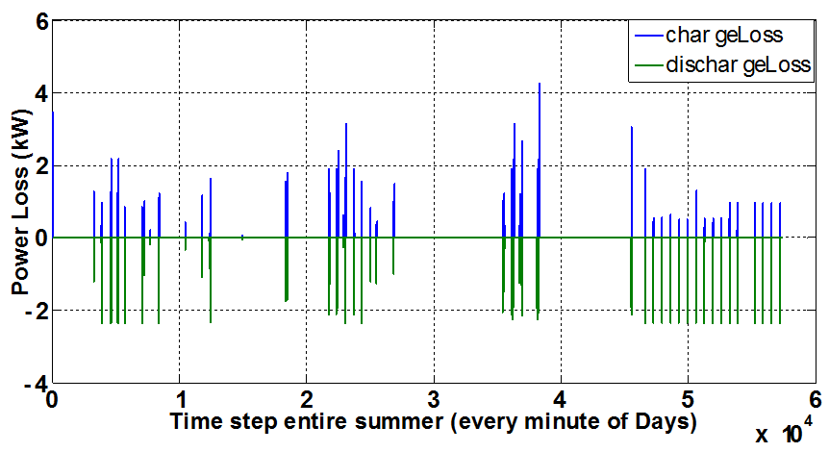
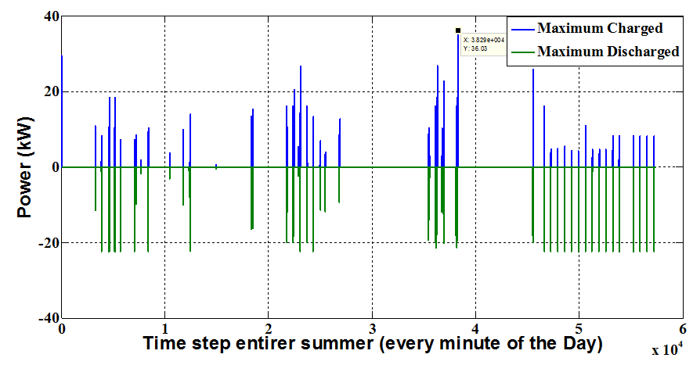
5. charging and discharging analysis
Charge losses vs Discharge’s
Power charged vs Discharged
Max charge 36.03kW
Max discharge 22.36kW

Slide 9
6. Economic Analysis
ESS devices sold by $/kWh or $/kW,
uncertain and market fluctuations plays important role in the economics of certain types of ESS
some leading battery competitors cost/kWh range from $225/kWh to $300/kWh
United States Advanced Battery Consortium (USABC) goal is to cut down the cost to $150/kWh
DOE had set for 2014 the battery prices for PHEV to be $200 to $300/kWh (Fail to happen)
Current price, range $500-$600 to as high as $1100/kWh

Slide 10
6. Economic Analysis (Cont.)
Smoothing Intermittency
Shifting part of load
Energy capacity was 20 kWh
Average EV battery price $775/kWh
Total price was $15,878 (NEW)
Used battery: 1) EV owners or 2) Battery leasers
Range of used EV batteries $100/kWh to $170/kWh
Total cost was $3,475 (USED)
Energy capacity was 368kWh
Same price $/kWh (new)
Total price was $285,200 (NEW)
Same price $/kWh (Used)
Total cost was $62,560 (USED)

Slide 11
7. Conclusion
Large scale CPV grid integration was investigated
Second life EV batteries were proposed economical and waste disposal issues
ESS was split into two groups mainly, ESS1 and ESS2
Total energy capacity of the combined ESSs was 388kWh
Economic implications of the ESSs quantities were investigated
Beyond certain limits, the cost of ESS was much higher without significantly improving the overall system efficiency
Estimates of the cost-effectiveness through this approach based on current ESS prices were not conclusive
Could be cost effective if ESS battery pack drop to $375/kWh or lower

Slide 12
8. References
C. Singh and A. Lago-Gonzalez, "Reliability modeling of generation systems including unconventional energy sources," IEEE Trans. Power Apparatus and Systems, vol.PAS-104, no.5, pp.1049-1056, May 1985.
Y. Moumouni and R. Jacob Baker, " Application of Used Electric Vehicle Batteries to Buffer PV Output Transients,” submitted for publication in MWSCAS 2015.
H. Qian, J. Zhang, and W. Yu, “A High-Efficiency Grid-Tie Battery Energy Storage System,” IEEE Trans. Power Electron., vol. 26, no. 3, pp. 886–896, Mar. 2011.
A. Ostadi, M. Kazerani, and S. Chen, Shih-ken, “Optimal sizing of the Energy Storage System (ESS) in a Battery-Electric Vehicle,” Transportation Electrification Conference and Expo (ITEC), IEEE, pp.1-6, June 2013.
P. Wolfs, “An economic assessment of ‘second use’ lithium-ion batteries for grid support,” … Power Eng. Conf. (AUPEC), 2010 20th …, 2010.
S. J. Tong, A. Same, M. a. Kootstra, and J. W. Park, “Off-grid photovoltaic vehicle charge using second life lithium batteries: An experimental and numerical investigation,” Appl. Energy, vol. 104, pp. 740–750, Apr. 2013.
http://www.scientificamerican.com; web accessed on the 14th February, 2015.
D. Lee and R. Baldick, “„Limiting Ramp Rate of Wind Power Output using a Battery Based on the Variance Gamma Process”,” … Conf. Renew. Energies Power …, pp. 1–6, 2012.
P. Denholm and R. M. Margolis, “Evaluating the limits of solar photovoltaics (PV) in electric power systems utilizing energy storage and other enabling technologies,” Energy Policy, vol. 35, no. 9, pp. 4424–4433, Sep. 2007.
E. Cready, J. Lippert, J. Pihl, I. Weinstock, P. Symons, and R. G. Jungst, “Final Report Technical and Economic Feasibility of Applying Used EV Batteries in Stationary Applications A Study for the DOE Energy Storage Systems Program,” Sandia Natl. Lab., no. March, 2003.
J. Ventre, Photovoltaic systems engineering, Second. Boca Raton London New York Washington, D.C: CRC Press, 2004.
www.amstron.com, Web was accessed on December 12th, 2011.
A. M. A. K. Abeygunawardana, G. Ledwich, and S. Member, “Estimating benefits of energy storage for aggregate storage applications in electricity distribution networks in Queensland,” Power Energy Soc. …, 2013.
http://www.greencarreports.com/ , Web accessed on July 27 th, 2015.

Slide 13
Questions and Answers
Thank you,

